Slide 1

Business Crime Hub
PC Rebecca Flaherty & PC Ian Young
Rebecca.Flaherty@met.police.uk
Ian.young@met.police.uk
Businesscrime.mailbox@met.police.uk

Slide 2
Business Crime Hub
Who are the Business Crime Hub ?
We are a small team consisting on 1 inspector, 2 sergeants, 4 Police Constables, and 1 Special Constable.
What areas do we cover?
Our small team covers the whole of the Metropolitan Police area. We also engage with the National Business Crime Centre.

Slide 3
What is a business crime
Business Crime is ‘ any criminal offence that is committed against a person or property that is associated by the connection of that person or property to a business’.
What is the background of the Business Crime Hub
The Business crime Hub was formed just after the 2011 Riots. It was highlighted that the Met did not have consistent engagement with the business community.

Slide 4
What does the Business Crime Hub Do
Even though we are a small team, we try to cover as much as we can.
Business engagement
            Liaison between police and businesses
            Information sharing
Security advice
            Crime prevention advice
            Security surveys/ Environmental Visual Audits
            Problem solving
Partnership working
            Safer Business Action Days
            Business Crime reduction Partnerships
            London Safety Centre
            MoPAC
Projects & New Technology
            Op Retail
            Knife Crime – Responsible retailer
            Facial recognition

Slide 5
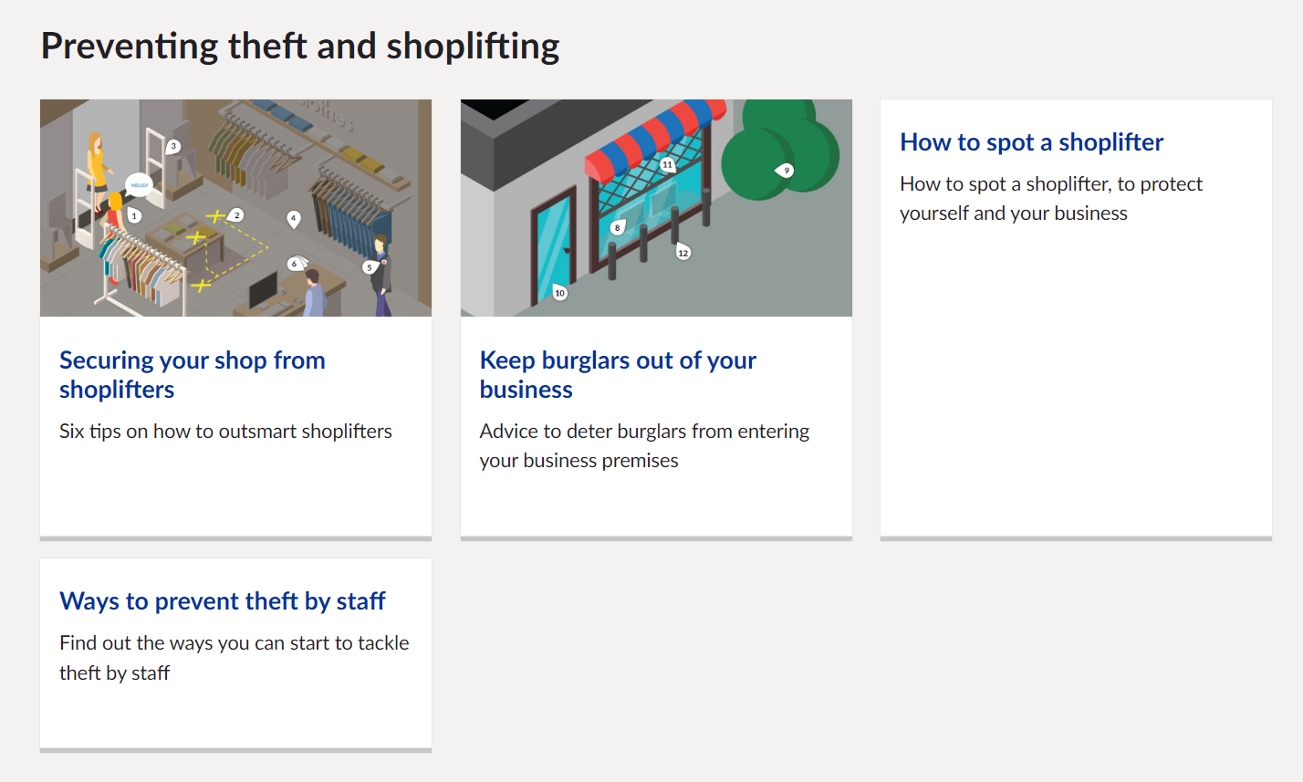
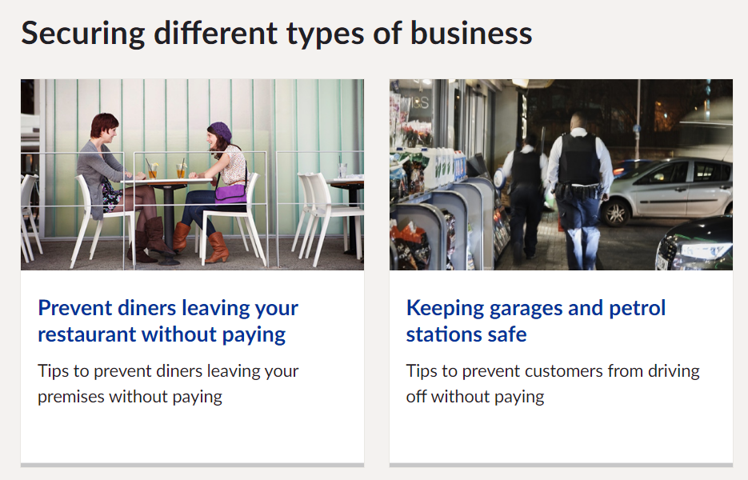
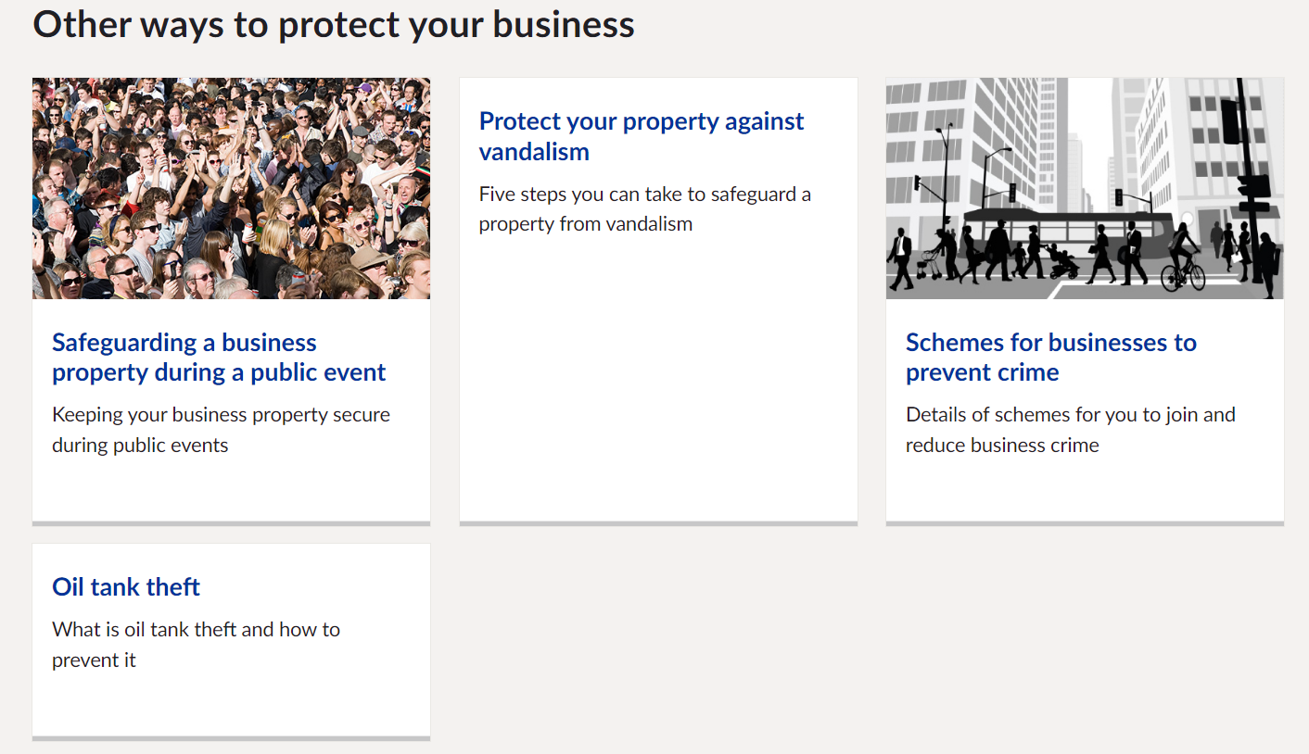
Crime Prevention
At the BCH we provide a wide variety of crime prevention advice
We can also provide Environmental Visual Audits (EVAs)
The met’s website has a section on Business Crime Prevention advice
We have also created advice in forms of 10 principles of crime prevention & Violence against staff
https://www.met.police.uk/cp/crime-prevention/keeping-business-safe-from-crime/
Advice can also be found on www.NBCC.police.uk

Slide 6
Problem Solving
Problem solving can take many forms, and can have many strategies to cope.
Crime Prevention and problem solving can go hand in hand.
If you are having particular problems we can conduct a Environmental Visual Audit, where we will create a report which will have recommendations of actions you need take. Or we can provide you with crime prevention advice which you can then utilise to solve the problem.
We also work with partner agencies and different departments in the met, to work in partnership to solve problems.
One of these is partners is OPAL which is formed of police officers nationally who tackle serious and organised acquisitive crime. Obviously the MPS has come out top for the most offences committed during this week (thefts and violence), followed closely by Sussex, Northamptonshire and Surrey forces. Overall Mondays and Tuesdays have the largest number of offences committed on, with a small decline on Friday and Saturdays. Times are from 4pm – 6pm where we see the largest number of offences committed on each day of the week, followed closely by noon to 2pm.

Slide 7
Impact on lack of reporting
If a crime isn’t reported we don’t know it is happening.
The met has to prioritise its resources, we rely on our data, which is mainly based on crime reporting. If one store reports 50 crimes but another reports only 5, the problem form our point of view would be at the store with 50 crimes
more police resources will be placed in the area with the higher crime rate.
BUT …
In reality they may both experience the same level of crime
When crime is reported we still need support from staff at the store, if they won’t support a prosecution the case will not be taken further.

Slide 8
Op Retail - Overview
OP Retail is the stream lining of ‘simple’ Theft from Shop crime reporting to the MPS where no offender is detained and no violence or abuse has occurred.
Op Retail aims to streamline the process of CCTV retrieval, making the process easier and resource / time intensive for both informants (retail store staff) and officers. Removing the need for officers to attend the venue to take the statement and retrieve the CCTV put the onus on the informant to fill in and return the pack, thus saving travel and administration time for officers and removes the need to book a suitable date and time to attend at the informant’s convenience.
The pack is completed at the informant’s discretion and also removes the possibility of informants being ‘let down’ by the police not attending due to conflicting workloads, which in turn could help sustain a good working relationship between retailers and the police.
You should all have heard of Op Retail by now so if you have any questions about this please ask at the end.

Slide 9
Steaming
What is Steaming?
Is a group employing distraction tactics, intimidation or actual violence against staff to commit theft. Also known as Flash Rob or Flash Mob Robberies. The National Retail Federation call them “Multiple Offender Crimes” using “Flash Mob Tactics”.
Basic Crime Prevention Advice:
* Security Officers, where possible, should be visible
* Minimise the number of entry points
* Check and test building security and emergency systems
* Ensure CCTV coverage is fully operational and can provide highest recording resolution
* Ensure the outside areas are clear of debris, dustbins, ladders, tools and equipment
* All staff should remain vigilant
MPS Strategy:
* Social media monitoring * Communication to businesses * Increased police presence * Robust action and tactics to apprehend, prevent and deter offences * Facial recognition and digital assets to identify offenders

Slide 10
Staying Safe:
* Head to a place of safety like a staff or store room
* Dial 999 asking for police
* Monitor CCTV and update authorities in real time
* Where possible alert other stores via town link radios etc.
* Do not engage with offenders especially if weapons seen/intimated
* Yours and customer safety is paramount
Effective Reporting:
* Activate your panic alarm AND dial 999 / get to a place of safety
* Be clear when speaking with the operator, state location and that a Robbery is taking place with any injuries
* Make sure you include any weapons seen or perceived – this could be objects in pockets and even verbal threat of “I’ve got a knife” and “I’m gonna f**k you up” – you and the customers are priority being in fear for your safety. This also adds to the severity and urgency of a police response
* Include the number of offenders, descriptions (male, female, height, build, skin colour, accents, etc.) plus any identifying clothing etc.* When officers are on route they will be actively looking for these descriptive factors*
* State the actions, threats, verbal language used, the groups demeanour, recklessness, language, their aim or goal for entering the store, plus any items that have been stolen
* The operator will ask you the above list of questions and more to aide officers on route so make sure you articulate them as clearly and as concise as possible. If you can visually try to remember any offenders faces/eyes/distinguishing marks, and clothing because you will be asked “Would you recognise any of them again?” and/or “do you know these offenders?” FINALLY: Listen to the officers on scene, they are in charge of injuries, suspects and property
“do you know any of these offenders?”
* Listen to the officers on scene – They now are in charge of injuries, suspects and property

Slide 11
Staff - Risk Management & Violence Against Women & Girls (VAWG)
Knife crime engagement: We were successful in applying for three hundred thousand pounds(£300k) resourcing from the Home Office STAR funding in the summer of 2022 (one of seventeen projects approved nationally). One of our key problems when talking to manufacturers & retailers was that outside of homicide, we can’t tell people with accuracy what knives are being used on the street. We are currently in the process of creating an image recognition engine for knives in conjunction with the University of Surrey that aims to tell you the type, manufacturer and model of a knife instantly once a photo is taken of it. This will then be trialled on Operation Sceptre weeks nationally to prove benefit, with an end goal of being used nationally to allow officers to identify knives on the street and inform enforcement action.
Violence against retailers meeting: We created a quarterly ninety minute meeting with all the UK business leads across a diverse range of retailers from retailers to restauranteurs, to discuss violence in our stores to allow retailers a direct voice to the MPS-to set aside any commercial rivalries and to collaborate working stratagems, share intelligence and build relationships. This meeting has gone from strength to strength.

Slide 12
Business Impact Statements
IMPACT STATEMENT FOR BUSINESS Criminal Procedure Rules, r 27.2; Criminal Justice Act 1967, s. 9; Magistrates; Courts Act 1980, s. 5BThe Impact Statement for Business (ISB) gives you the opportunity to set out the impact that a crime has had on the business such as direct financial loss, and wider impacts, e.g. operational disruption or reputational damage.
The court will take the statement into account when determining sentence. In this statement you should not provide an opinion or recommendation on the sentence or sanctions that the court should use. This is for the court to decide. You should limit the information you give in this statement to the impact this particular crime has had on the business, rather than providing information on how any previous criminal activity may have affected the business (unless, for example, this crime results from the repeat offending of the same offender).
The business should consider carefully who to nominate as the representative to make the statement on its behalf. Once you have completed this form, you should return it by email or by post to your police contact. A person making an ISB on behalf of a corporation (“the nominated representative”) must be authorised to do so on its behalf. The nominated representative must also be in a position to give evidence that is admissible in court about the impact of the crime on the business. The nominated representative may be required to answer questions on the ISB in court. You should be aware that if you choose not to make a statement at the outset of the proceedings, you may not have another opportunity to make one later on. This is because the case may be dealt with by the courts very quickly. In more complex cases which may take longer to be dealt with by the courts, you may wish to take more time to collect relevant information, for example, accounts or other business documents. The police will be in touch to let you know the date of the first hearing date and at that stage, you will need to make or update your ISB through your nominated representative.

Slide 13
Going To Court
Once a crime has been reported to the police, the investigation may lead to a suspect being charged for the crime. The Crown Prosecution Service (CPS) will normally make the decision on whether there is enough evidence to bring the case to court, although in some cases the police will decide. If your case does not go to court, you should be told the reason for this decision by either the police or CPS. You can ask for this decision to be reviewed if you are unhappy with it. This would be done through the Victims’ Right to Review Scheme.
If your case does go to court, you may be a witness in the trial. If the suspect pleads not guilty, you will be allocated a Witness Care Officer or other point of contact who will keep you up to date about what’s happening in the trial and answer any questions you have. You will usually hear from the Witness Care Officer once the suspect has been charged, and they will continue to support you until the case is over. They will let you know court dates and locations and whether the suspect has been released on bail or is being held in custody until the trial begins. They may also be able to arrange a visit to the court before the day if you would like. Your Witness Care Officer or other point of contact, will consider what, if any, support you might need to attend court. This includes whether you could benefit from any Special Measures.
Special Measures are a series of options that the court has to help give your best evidence. Vulnerable or intimidated victims and witnesses can ask for Special Measures to be used during the trial to help them give their best evidence in court. These measures include:• Having screens around the witness box or giving evidence by live video-link so you do not have to face the suspect or their family;• Having the court case held in private – with no press or public allowed;• Having someone (an intermediary)to help you to understand questions when being interviewed. You can ask your Witness Care Officer or other point of contact for more information. The court will make the final decision on whether you can use Special Measures during the trial, but will take your views into account.

Slide 14
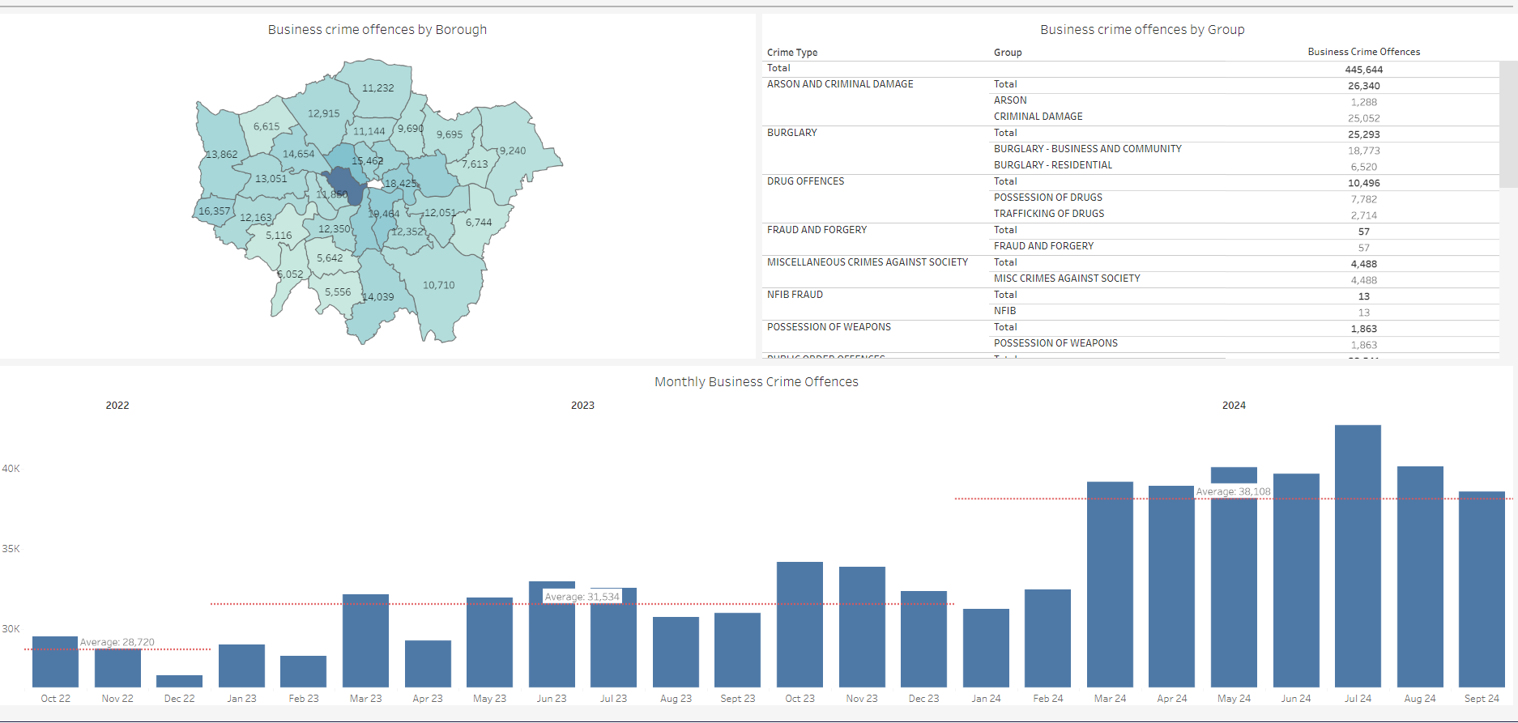
Trends
Business crime Dashboard
Overall Data for the MPS for the last 12 months

Slide 15
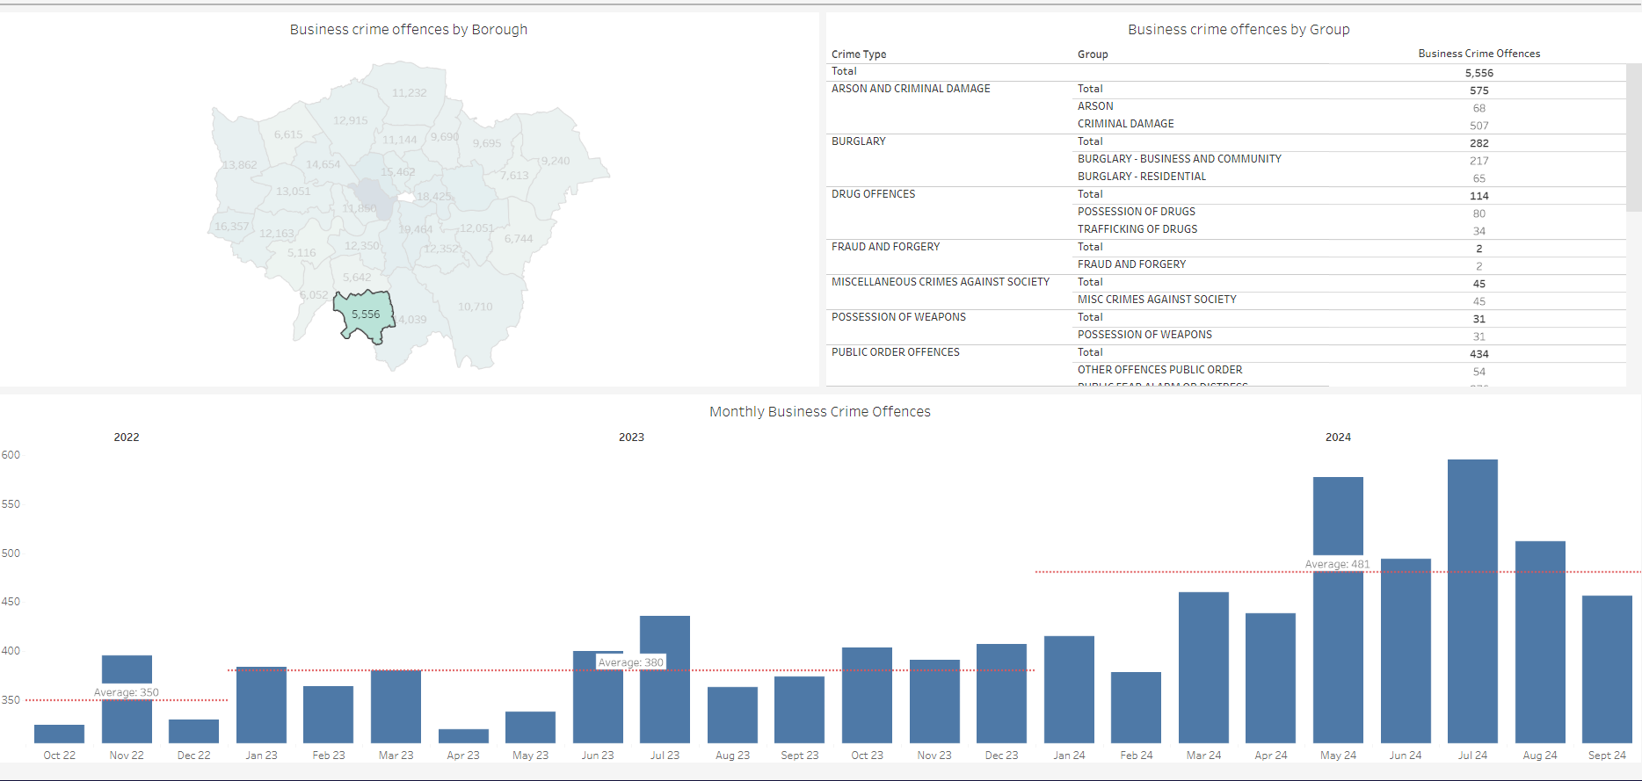
Trends
Data for Sutton for the last 12 months – all crime types

Slide 16
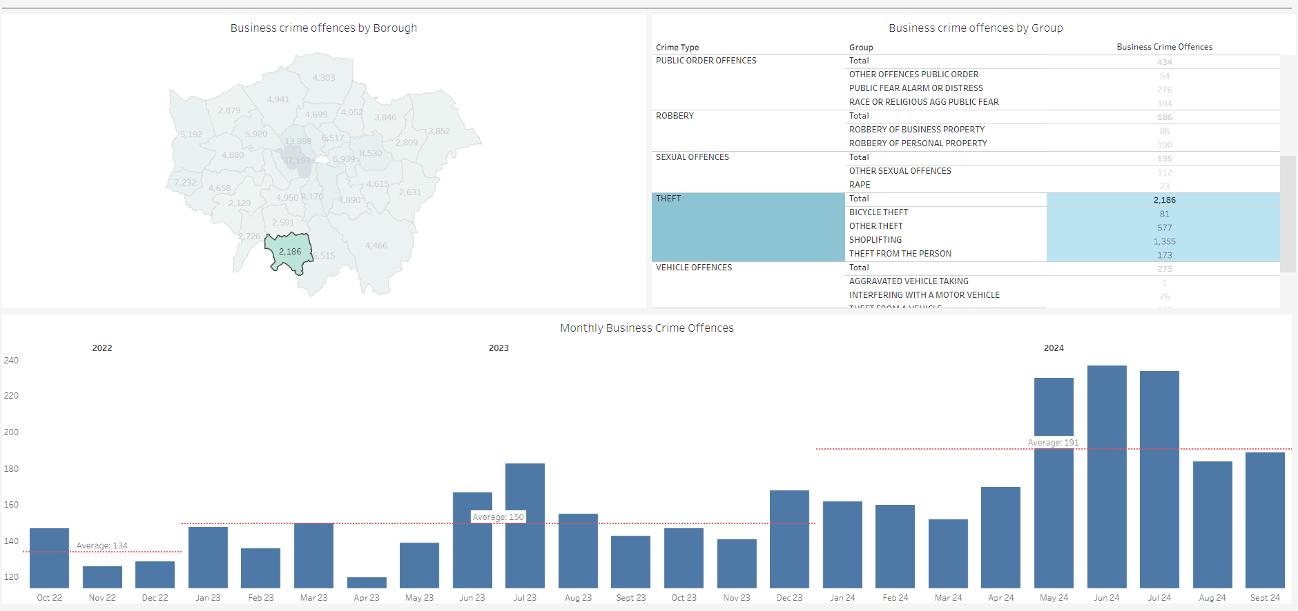
Trends
Sutton - Theft offences

Slide 17
Questions

Slide 18
Contact details
PC Rebecca Flaherty
Rebecca.Flaherty@met.police.uk
Businesscrime.mailbox@met.police.uk
Mob: 07584156867
Insp Titus Halliwell
Sergeant Will Davies
Sergeant Stephen Simpson
PC Trevor Hamshere
PC Al Diaz
PC Ian Young
SPC Steve Lewis
PC Ian Young
Rebecca.Flaherty@met.police.uk
Businesscrime.mailbox@met.police.uk
Mob: 07776 673658

